Slide 1
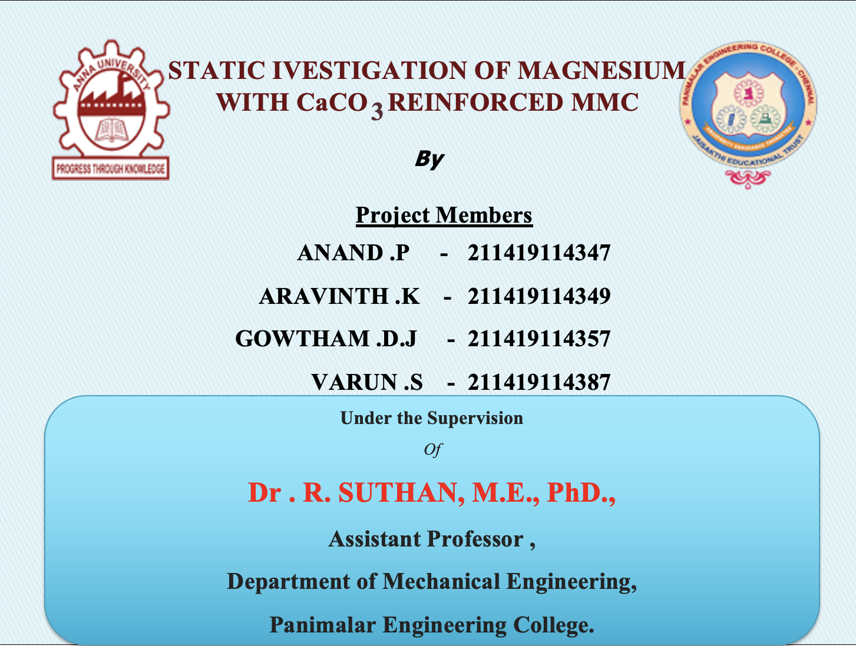
Static investigation of magnesium with CaCO3 reinforced MMC
‏
1
Notes:
1
1

Slide 2
ABSTRACT
The MMC plays a major role in joining heat treatable magnesium with CaCO3 which are widely used in aerospace and automobile industries.
These casting joints have higher tensile strength to weight ratio and finer micro structure.
MMC of magnesium with CaCO3 have the potential to hold good mechanical and metallurgical properties.
This is because of many of its advantage over the conventional composite techniques which include very low distortion, no fumes, porosity or spatter, no consumables (no filler wire), no special surface treatment and no shielding gas requirements.

Slide 3
ABSTRACT Cont…
The aim of this project work is to optimize maximum tensile strength of selected process parameter of MMC of magnesium with CaCO3 material by using Taguchi L₈ orthogonal design of experiments.
The microstructure and hardness of the material is used to identify the comparison between the base metal and casting area.
The casting of similar material magnesium with CaCO3 plates was carried out using (mmc) technique.
Speed, Force, and Feed rate these parameters are taken into consideration.
The optimum process parameters were determined with reference to tensile strength and hardness of the joint.

Slide 4
SCOPE OF THE PROJECT
SCOPE
The welding of magnesium with CaCO3 of is extensively used in aerospace and automobile industries. The microstructure and mechanical study of welding this alloy enables us to evaluate the applicability to the different applications.
This specification covers the specific requirements for magnesium with CaCO3 bar, rod, shapes, tube and wire produced by extrusion.
Notes:
4
4

Slide 5
OBJECTIVE OF THE PROJECT
OBJECTIVE
The objective of the project work is to evaluate the microstructure and to study the mechanical properties of the casting of magnesium with CaCO3.
The main focus of the present work is to analyze the casting of magnesium with CaCO3 and to optimize the process parameters of the casting magnesium with CaCO3.

Slide 6
LITERATURE SURVEY
M. Koilraj, V. Sundareswaran, S. Vijayan, and S.R. Koteswara Rao have
investigated its CASTING of dissimilar aluminum alloys AA2219 to
AA5083 –Optimization of process parameters using Taguchi technique.
Title | Year | Parameters | Work Piece | Tool | Testing | Conclusion
MMC of AA2219-AA5083 | 19 August 2010 |  | Length-150mm Width- 65mm Thickness- 10mm | Straight Cylindrical Pin (SCP) | Microstructure, Hardness, Tensile test | R.S= 700rpm Feed= 15mm/min D/d= 3

Slide 7

WORK PIECE SELECTION
Work Piece
Magnesium with CaCO3, (100X100mm)
Thickness : 6.8mm
Length & Width : 100 mm

Slide 8
MACHINING PARAMETERS WITH THEIR LEVELS
Three input parameters with three two levels were selected.
Level | Speed(rpm) | Load (KN) | Feed Rate (mm/sec)
1 | 800 | 5 | 1.3
2 | 600 | 6 | 1.4

Slide 9
TWO LEVELS THREE FACTORS EXPERIMENTAL LAYOUT – L₈ ORTHOGONAL ARRAY
Exp.No | A Speed | B Force | C Feed Rate
1 | 1 | 1 | 1
2 | 1 | 1 | 2
3 | 2 | 2 | 1
4 | 2 | 2 | 2
5 | 1 | 2 | 1
6 | 1 | 2 | 2
7 | 2 | 1 | 1
8 | 2 | 1 | 2

Slide 10
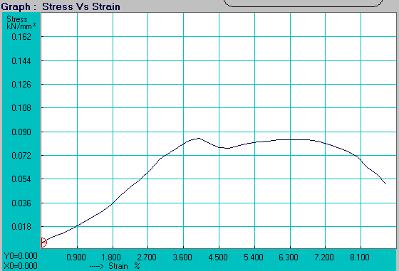
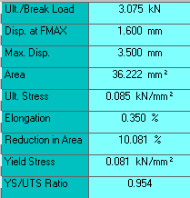
TESTING METHODS & RESULTS
GRAPHICAL REPRESENTATION FOR TENSILE TESTING TO THE MMC SAMPLES:

Slide 11
TENSILE
Tensile test values
Exp. No | Speed (rpm) | Force (KN) | Feed Rate (mm/s) | UTS (MPa) | Elongation % | Yield Stress (MPa)
1 | 800 | 7 | 1.2 | 85 | 0.350 | 81
2 | 800 | 7 | 1.8 | 69 | 0.850 | 68
3 | 120 | 8 | 1.2 | 100 | 3.500 | 81
4 | 1200 | 8 | 1.8 | 72 | 2.450 | 62
5 | 1000 | 8 | 1.2 | 87 | 1.775 | 84
6 | 1000 | 8 | 1.8 | 64 | 2.075 | 54
7 | 1400 | 7 | 1.2 | 90 | 3.000 | 88
8 | 1400 | 7 | 1.8 | 98 | 2.525 | 97

Slide 12
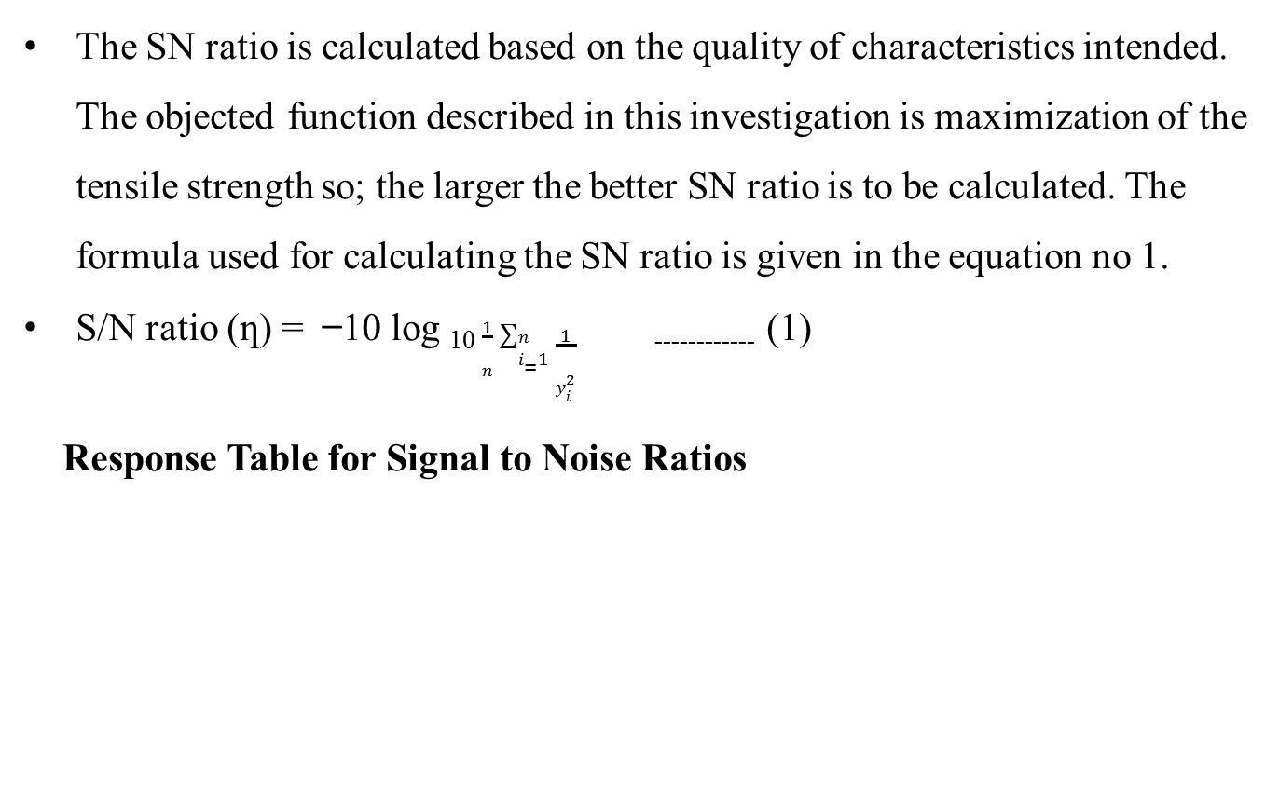
SIGNAL TO NOISE RATIO
The SN ratio is calculated based on the quality of characteristics intended. The objected function described in this investigation is maximization of the tensile strength so; the larger the better SN ratio is to be calculated. The formula used for calculating the SN ratio is given in the equation no 1.
S/N ratio (ƞ) = ̶ 10 log ₁₀ $\frac{1}{n}\sum_{i=1}^{n}{\frac{1}{y_{i}^{2}}}$ ₋₋₋₋₋₋₋₋₋₋₋₋ (1)
Response Table for Signal to Noise Ratios
Level | A | B | C
1 | 37.57 | 38.57 | 39.12
2 | 39.01 | 38.02 | 37.47
Delta | 1.44 | 0.55 | 1.65
Rank | 2 | 3 | 1

Slide 13
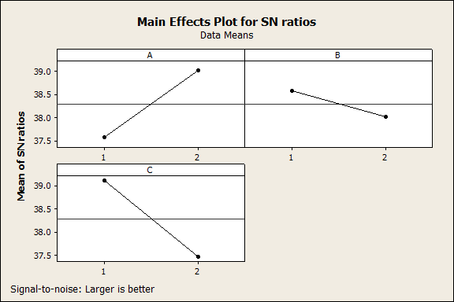
Main effects for SN ratio are plotted
The optimal setting parameters based on SN ratio is A₂ B₁ C₁

Slide 14
ANALYSIS OF VARIANCE FOR SN RATIOS
Source DOF Seq SS Adj MS F P %
A 1 4.1712 4.1712 4.45 0.282 28.688
B 1 0.6128 0.6128 0.65 0.567 4.2146
C 1 5.4316 5.4316 5.80 0.251 37.356
A*B 1 0.2150 0.2150 0.23 0.716 1.4786
A*C 1 0.6989 0.6989 0.75 0.546 4.2146
B*C 1 2.4735 2.4735 2.64 0.351 17.011
Residual 1 0.9368 0.9368 - - 6.4430
Error
Total 7 14.5398 100
DOF – Degree Of Freedom, Seq SS – Sequencial sum of squares,
Adj MS – Adjusted Mean Squares, F – Fisher ratio.

Slide 15
COMPARISON OF VARIOUS PARAMETERS FOR TENSILE VALUE OF SN RATIO:
The chart clearly shows that by increasing Speed and force of the tools, the SN Ratio value was increased; when the Feed rate is increase the SN Ratio was decreased.

Slide 16
DISCUSSION
The tensile strength of the casting is analyzed to study the effects of the mmc process parameters.
This result clearly shows that, seventh experiment is good performing process parameter
Increasing Speed and Force of the tools, the SN Ratio value was increased
When the Feed rate is increase the SN Ratio was decreased.

Slide 17
HARDNESS
Hardness values
Exp.No | Speed (rpm) | Force (KN) | Feed Rate (mm/s) | Tool | Base Material 6063 | Welded Zone
1 | 1000 | 7 | 1.2 | Cylinder pin | 44 | 47
2 | 1000 | 7 | 1.8 | Cylinder pin | 43 | 48
3 | 1400 | 8 | 1.2 | Cylinder pin | 48 | 54
4 | 1400 | 8 | 1.8 | Cylinder pin | 43 | 45
5 | 1000 | 8 | 1.2 | Cylinder pin | 45 | 53
6 | 1000 | 8 | 1.8 | Cylinder pin | 47 | 51
7 | 1400 | 7 | 1.2 | Cylinder pin | 44 | 48
8 | 1400 | 7 | 1.8 | Cylinder pin | 44 | 53

Slide 18
COMPARISON OF VARIOUS SAMPLES:
HARDNESS ,BHN
Experiment
DISCUSSION
The hardness result is clearly shows in comparing the hardness value of welded zone and base, experiment 8 shows the better performance.

Slide 19
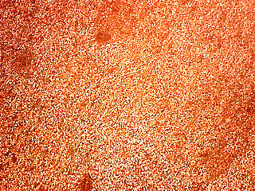
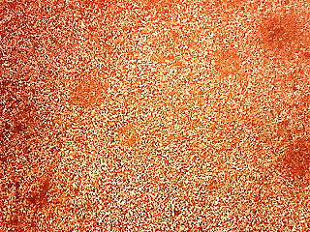

MICROSTRUCTURE
Parent Zone
TMAZ Zone
Nugget Zone

Slide 20
DISCUSSION
The parent metal in softened condition with the precipitates of magnesium with CaCO3 particles.
At the nugget zone, the grain sizes were smaller than the base metals (Parent Zone) and TMT zone of zinc alloy and also it contains small porosity formations.

Slide 21
CONCLUSION
The casting process parameters were optimized with respect to tensile strength of the joint and the optimum level of setting were found out.
The optimum levels of the Speed, Force and Feed Rate are 1400 rpm, 7 KN and 1.2 mm/s respectively.
The transverse Feed Rate plays a vital role and contributes 37.3567% to the overall contribution.
Increasing Speed and force of the tools, the SN Ratio value was increased, and Feed rate is increasing the SN Ratio was decreased.

Slide 22
CONCLUSION Cont…
Comparing the hardness value of welded zone is higher than the base metal.
Based on the microstructure the welded zone grains were highly mixed together and giving good results only at Speed =1400rpm, Force = 7KN, and Feed Rate = 1.2mm/s.
From the microstructure, when compared with base material, stir zone was having fine grain structure irrespective of the parameters.

Slide 23
REFERENCES
Bhanodaya. N, Kiran Babu, Prabhu Kumar. A and Joseph Davidson. M (2011) ‟ A Review of Friction stir Welding of AA 6061 Aluminium Alloy”, VOL-6.
Elangovan. K, Balasubramanian. V, and S. Babu (2007) ‟ Friction Stir Welded AA6061 Aluminium alloy ”, by a Mathematical Model, Volume 28.
Elangovan, K, Balasubramanian.V, Babu. S, and Balasubramanian. M (2008) ‟ Optimizing Friction Stir Welding Parameters to Maximize Tensile Strength of AA6061 Aluminium alloy joints”, Metals and Materials Internnational, volume 15.
Hidetoshi Fuji, Ling Cui, Masakatsu Maeda and Kiyoshi Nogi (2005) ‟Effect of Tool Shape on Mechanical Properties and Microstructure of Friction Stir Welded Aluminum Alloys”, Harbin Institute Technology Publishers, pages 561-565.
Karthikeyan. L, Puviyarasan. M, Sharath Kumar. S, and Balamugandan. V (2012) ‟Experimental studies of Friction Stir Welding of AA 2011 and AA 6063 Aluminium Alloys”, Vol-III.
Koilraj. M, Sundareswaran. V, Vijayan. S, and Koteswara Rao.S.R (2012) ‟ Friction Stir Welding of dissimilar aluminum alloys AA2219 to AA5083-Optimization of process parameters using Taguchi Technique.

